Slide 1
SOFTWARE PROJECT LAB -1
PRESENTED BY
JITESH SUREKA
Class Roll : 1115
Exam Roll : 1129
SUPERVISED BY :
DR. AHMEDUL KABIR
Assistant Professor
IIT, University of Dhaka

Slide 2
Language Used : C/ C++ GITHUB LINK: https://github.com/jsureka/SPL1
Project Name : ImageX Image processing tools

Slide 3
PROJECT MOTIVATION
Wanted to explore the image manipulation side of the technology field
Want to work on a bigger project which will require rigorous work on image manipulation

Slide 4
PROJECT OBJECTIVES
Deliver a fully functional software with interactive user interface
Edit any 24-bit bitmap image
Apply eight image processing algorithms to an image
Save an edited image for future purposes

Slide 5
TOOLS
Edge Detection
Grey Scaling
Smoothing
Brightening
Blurring
Noise Generation
Halftoning
Sharpening

Slide 6
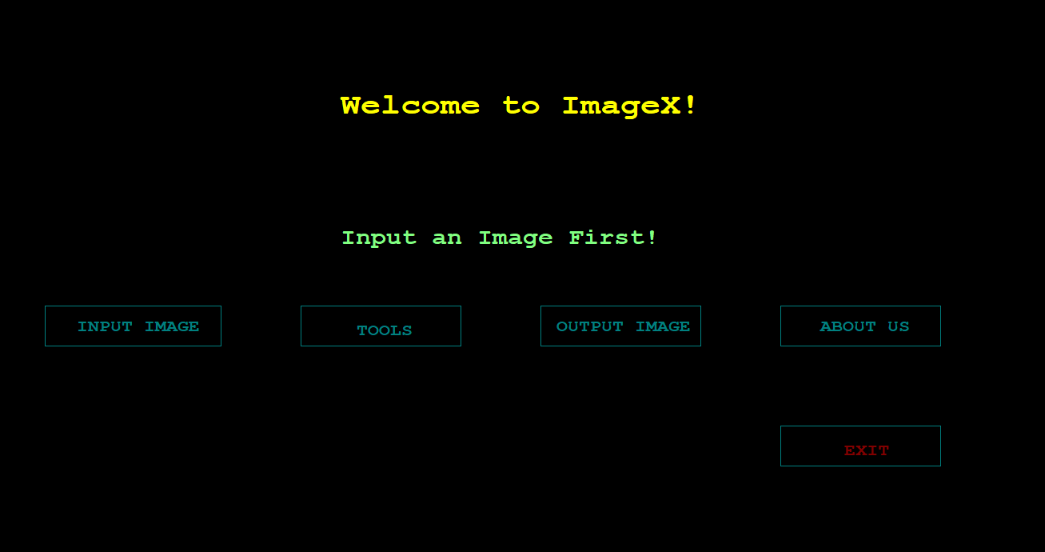
Home Screen
After running the software, it will ask
to input a image, after clicking, it will take
the user to the command prompt for
input

Slide 7
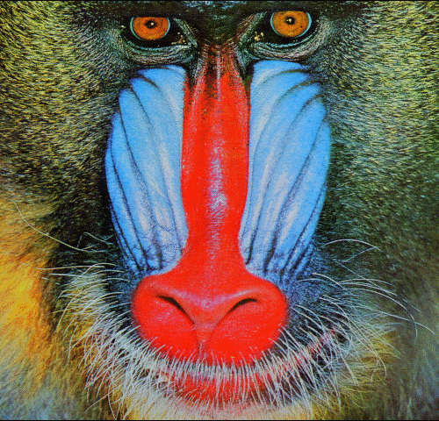
READING AN IMAGE
Reading the baboon.bmp image as input
Reading header info
Reading pixel data
Storing the data in structure variables

Slide 8
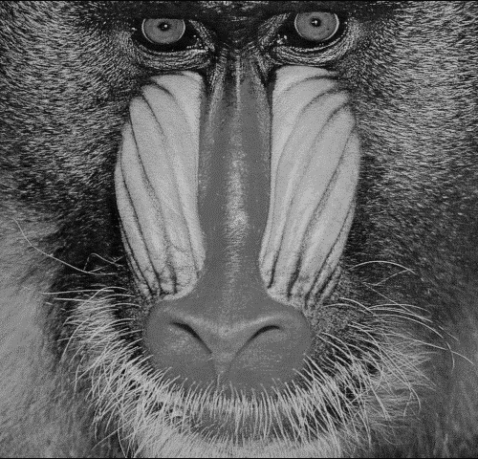
WRITING THE PROCESSED IMAGE
Opening a new file in writing mode
Writing header info
Writing the modified pixel data
Closing the file

Slide 9
RESULTS OF THE TOOLS

Slide 10
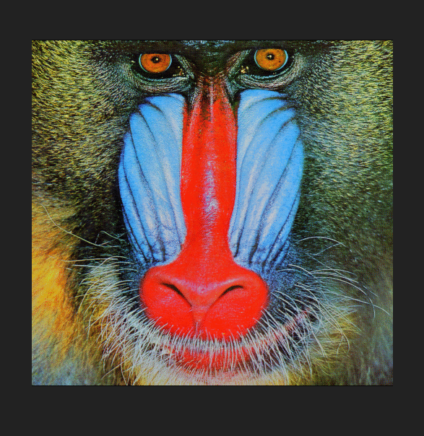
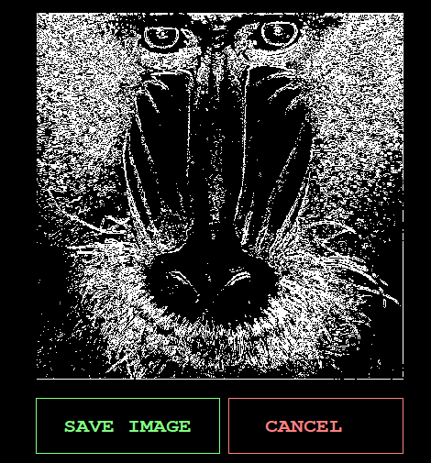
EDGE DETECTION

Slide 11
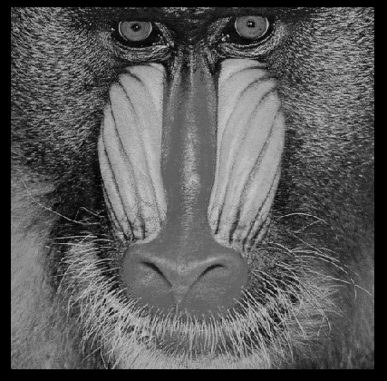
GREY SCALING

Slide 12
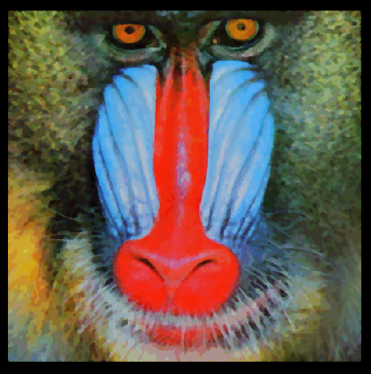
SMOOTHING

Slide 13
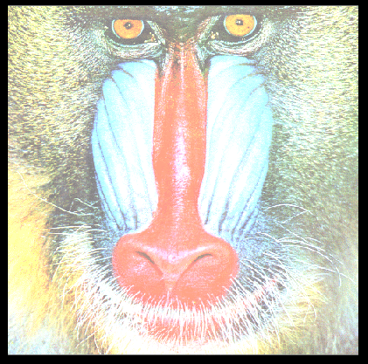
BRIGHTENING

Slide 14
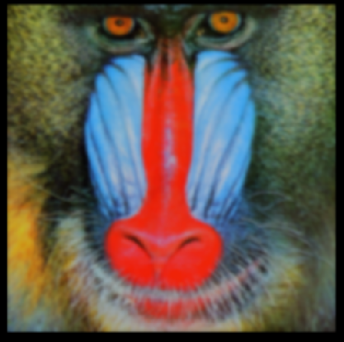
BLURRING

Slide 15
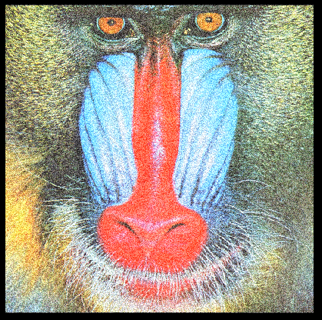
NOISE GENERATION

Slide 16
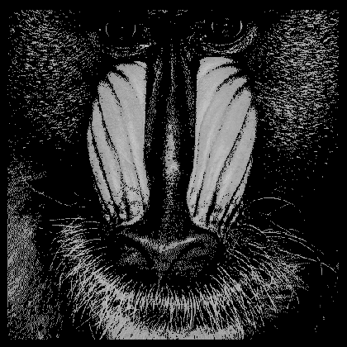
HALFTONING

Slide 17
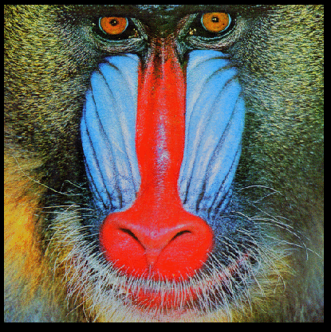
SHARPENING

Slide 18
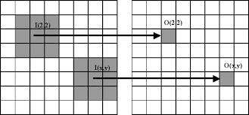
MEDIAN FILTER

Slide 19
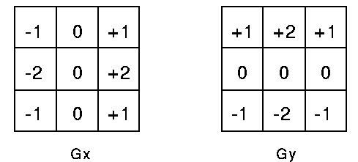
SOBEL’S OPERATOR

Slide 20
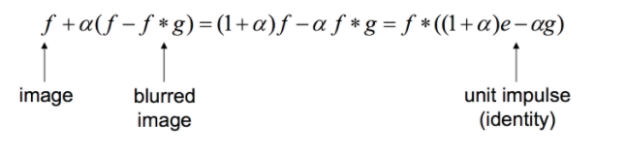
Unsharp Masking

Slide 21
Future Scopes
Every tool is implemented as a function, these functions can be used as a

Slide 22
REFERENCE LINKS
James D. Murray; William vanRyper (April 1996). Encyclopedia of Graphics File Formats (Second ed.). O'Reilly. os2bmp. ISBN 1-56592-161-5. Retrieved 2014-03-07.
https://www.tutorialspoint.com/cprogramming/c_file_io.htm
Foley, J. D.; Van Dam, A. (1982). Fundamentals of Interactive Computer Graphics. Reading, MA: Addison-Wesley. ISBN 0201144689.
Fulton, Wayne (1997–2010). "A few scanning tips, Sharpening - Unsharp Mask". Scantips.com. Archived from the original on 2019-04-27. Retrieved 1 October 2019.
Philippe Cattin (2012-04-24). "Image Restoration: Introduction to Signal and Image Processing". MIAC, University of Basel. Retrieved 11 October 2013.
Digital Image Processing 4th Edition by Rafael Gonzalez (Author), Richard Woods (Author)
Image Processing in C by Dwayne Philips
Campbell, Alastair. The Designer's Lexicon. ©2000 Chronicle, San Francisco.

